Slide 1
Models of Brain Development and Psychopathology

Slide 2
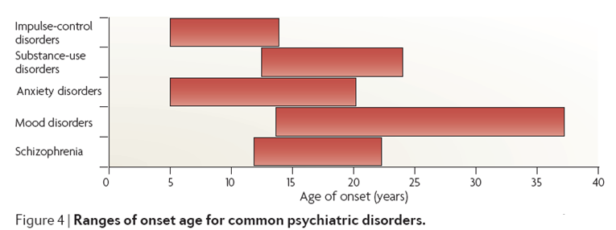
Adolescence: A Key Phase of Life for Health
Paus, Keshavan & Giedd, 2008, Nature Rev. Neuro.

Slide 3
Adolescence: A Key Phase of Life for Health
17%-22.6% of adolescents experience a depressive episode by age 18
Zisook et al. 2007. Effect of Age at Onset on the Course of Major Depressive Disorder. Am J Psychiatry, 164:1539-1546

Slide 4
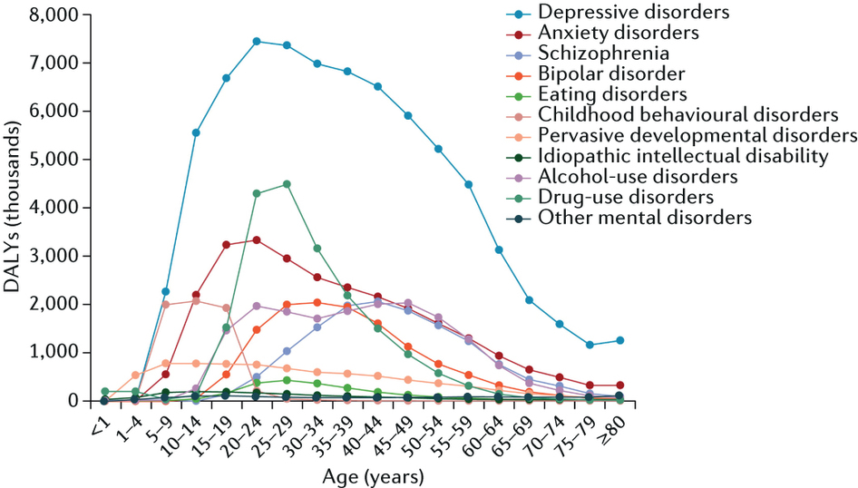
Adolescence: A Key Phase of Life for Health Across the Lifespan

Slide 5
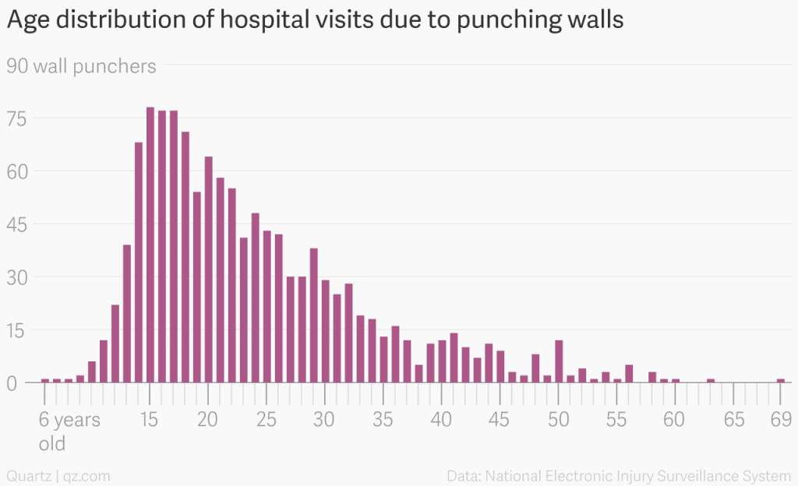

Slide 6
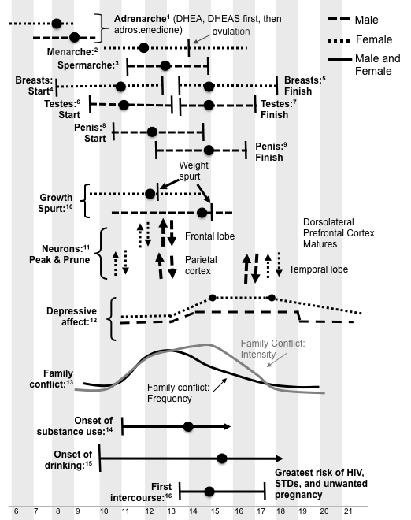
From Tom Hollenstein

Slide 7
Temporal relationships between brain development and adolescent mental Health
Cross-sectional association
Covariate (state)
Predictor
Individual difference (intercept)
Developmental process (slope)
Scar

Slide 8
Development fast and slow
How does abnormal maturation confer risk?
Advanced maturation could be a risk or protective factor:
Risk factor
Moving to a developmental phase before the previous one is complete (The “Big” effect)
One aspect of advanced development could place other aspects of on time development at risk (Doogie Howser effect)
Protective factor
Advanced maturation could provide enhanced skills compared to peers (Ferris Beuller effect)

Slide 9
Development fast and slow
Delayed maturation could be a risk or protective factor:
Risk factor
Poorer developmental capacities than peers (e.g., poorer self regulation) (Sean Penn Effect)
Protective factor
Delayed entry into risky contexts (e.g., peer contexts) (Revenge of the Nerds)

Slide 10
Relationship between brain development and other risk factors (e.g., genetic, environmental)
Moderators versus mediators
Brain
Brain
Stress
Mental Health
Stress
Mental Health

Slide 11
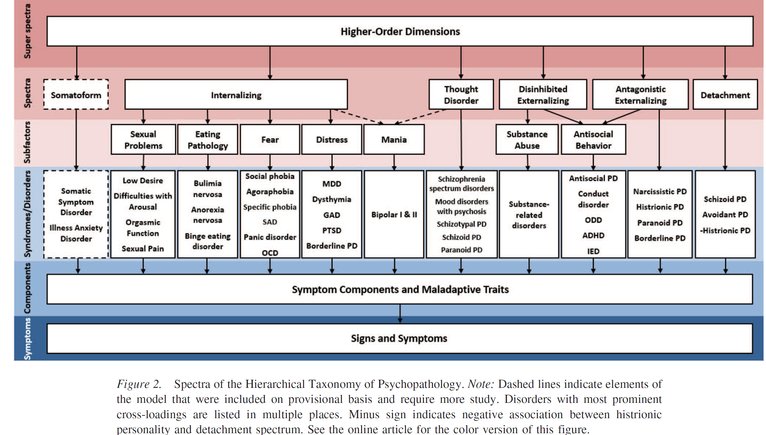
To lump or split?
Kotov, Krueger, et al., 2017
Notes:
In order for me to really focus on the very character of affective and behavioral dysregulation, I adopt the Hierarchical taxonomy of psychopathology model. The HiTOP model is an alternative to traditional psychopathology taxonomies defined in, for instance, the DSM (APA, 2013). It follows a quantitative psychiatric classification that operates on two levels: first, it constructs syndromes from the empirical covariations of symptoms; and second, it groups syndromes into spectra based on the covariation among them.
From the HiTOP model, disorders on the internalizing spectra were grouped to represent disorders of affective dysregulation, with the shared characteristics of eating pathology, fear, and distress. There are controversies in the literature regarding the nature of mania episodes in Bipolars. In order to concentrate on the key feature of affective dysregulation, bipolar disorders were excluded from the internalizing disorders group.
Then disorders from the disinhibited externalizing spectra were grouped together to represent disorders of behavioral dysregulation.
Both internalizing and externalizing disorders were coded as dummy codes, indicating yes or no on the lifetime presence of the disorder.

Slide 12
Example of brain measures as a mediator

Slide 13
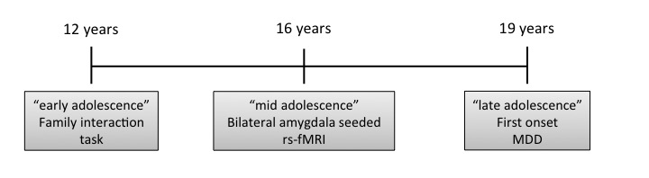

Slide 14
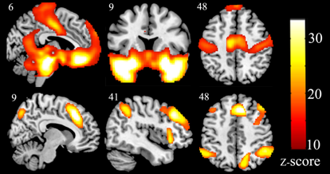
Significant clusters representing positive correlation (top row) and negative correlation (bottom row) with the whole amygdala seed

Slide 15
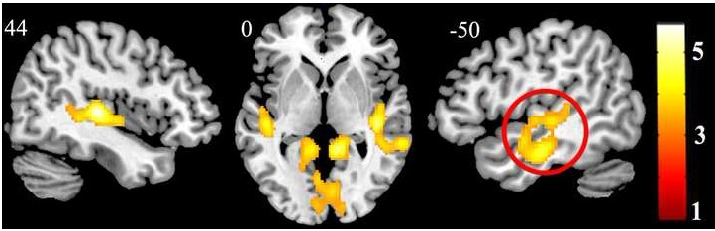
Association between amygdala connectivity and maternal aggressive behavior

Slide 16
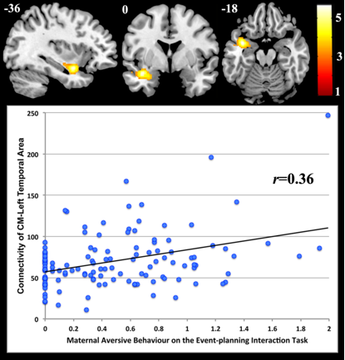
Association between CM amygdala connectivity and maternal aggressive behavior

Slide 17
Association between maternal aggression and adolescent onset MDD was mediated through whole amygdala-temporal/insula cortex connectivity

Slide 18
Association between maternal aggression and adolescent onset MDD was mediated through CM amygdala-temporal/insula cortex connectivity

